Slide 1




Extending Stress Detection Reproducibility to Consumer Wearable Sensors
Ohida Binte Amin^{1, 2}, Varun Mishra^{1, 2}, Tinashe M. Tapera^{1, 2},
Robert Volpe ², Aarti Sathyanarayana^{1, 2, 3}
Contact Information:
THE
¹Khoury College of Computer Sciences, Northeastern University, Boston, MA, ​
²Bouve College of Health Sciences, Northeastern University, Boston, MA,​
³Department of Biostatistics, Harvard T.H. Chan School of Public Health, Boston, MA
{amin.o, v.mishra, tapera.t, r.volpe, a.sathyanarayana}@northeastern.edu
LAB

Slide 2
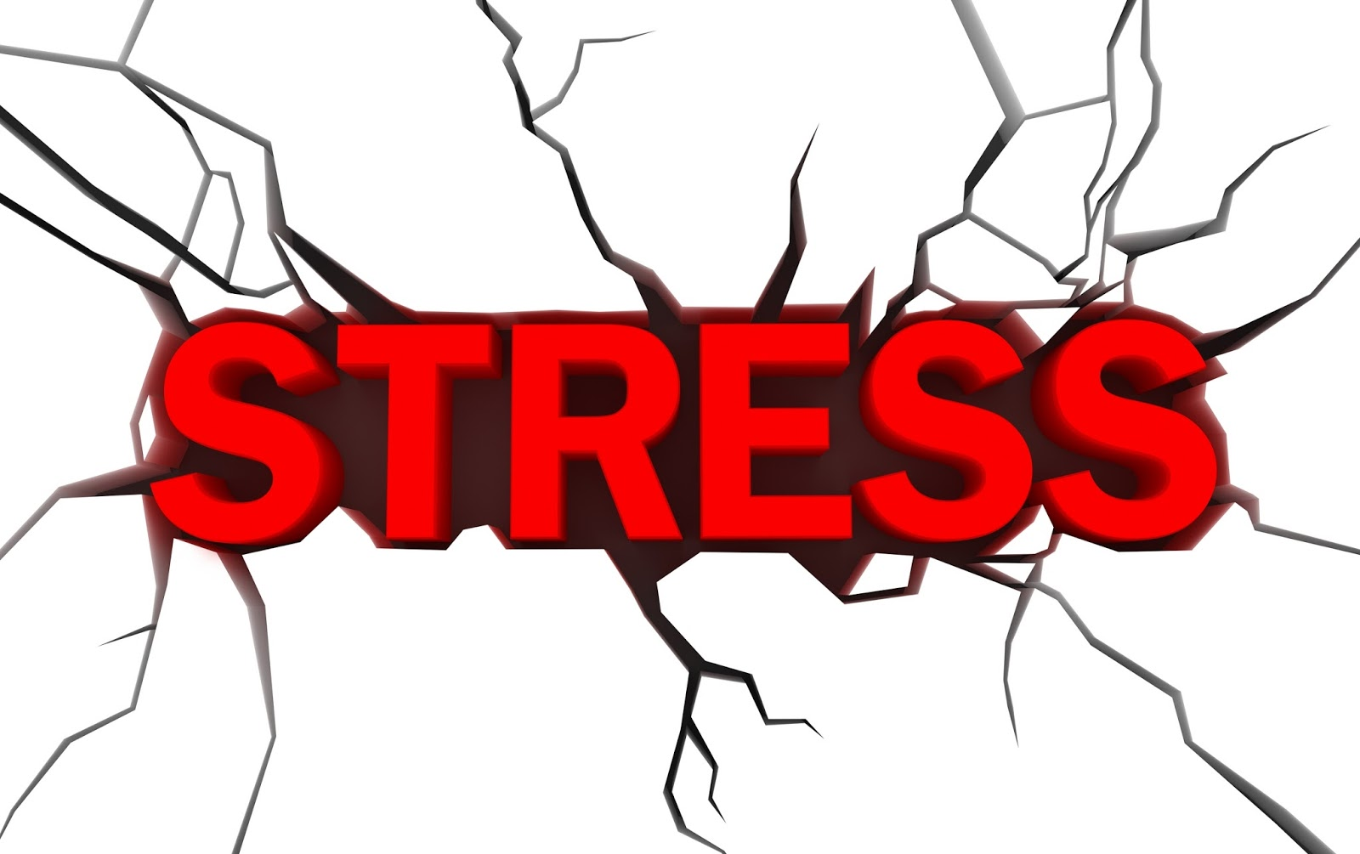
78% of undergraduates experience moderate to high stress, triggered by academic demands, changes in social environment, feelings of isolation, and incidents of harassment or discrimination…

Slide 3
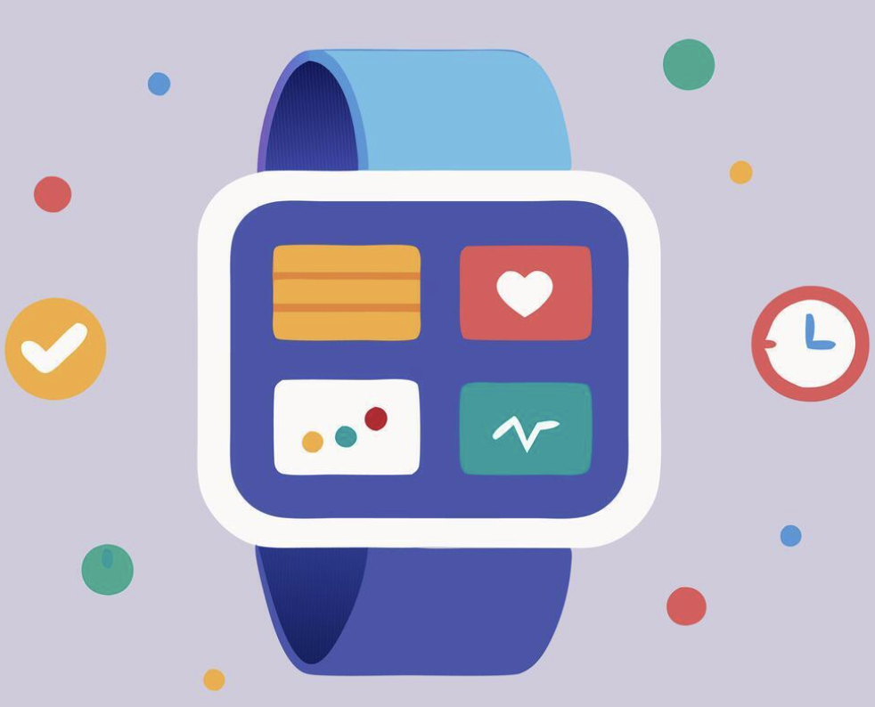

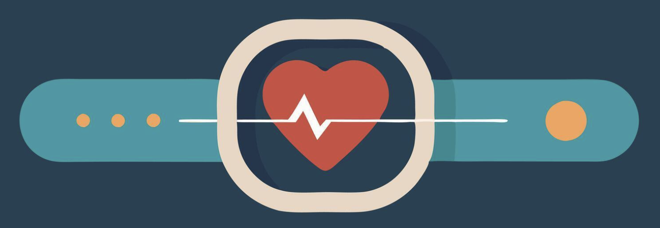
Wearables enable continuous stress monitoring by allowing consistent collection of high-quality biomarkers like HRV and EDA, which reliably indicate stress responses…

Slide 4



Stress is inherently subjective, with physiological responses varying from person to person…
Machine and deep learning techniques enhanced the effectiveness of stress detection using data from wearable devices…
Prior studies focused on a single dataset, rarely evaluating model reproducibility across devices, populations, or study conditions…

Slide 5
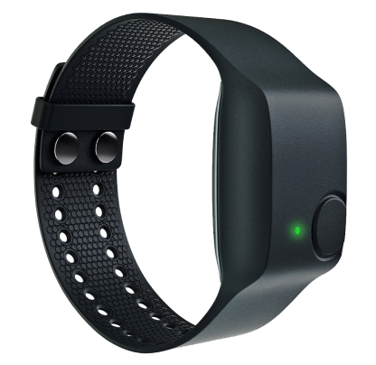
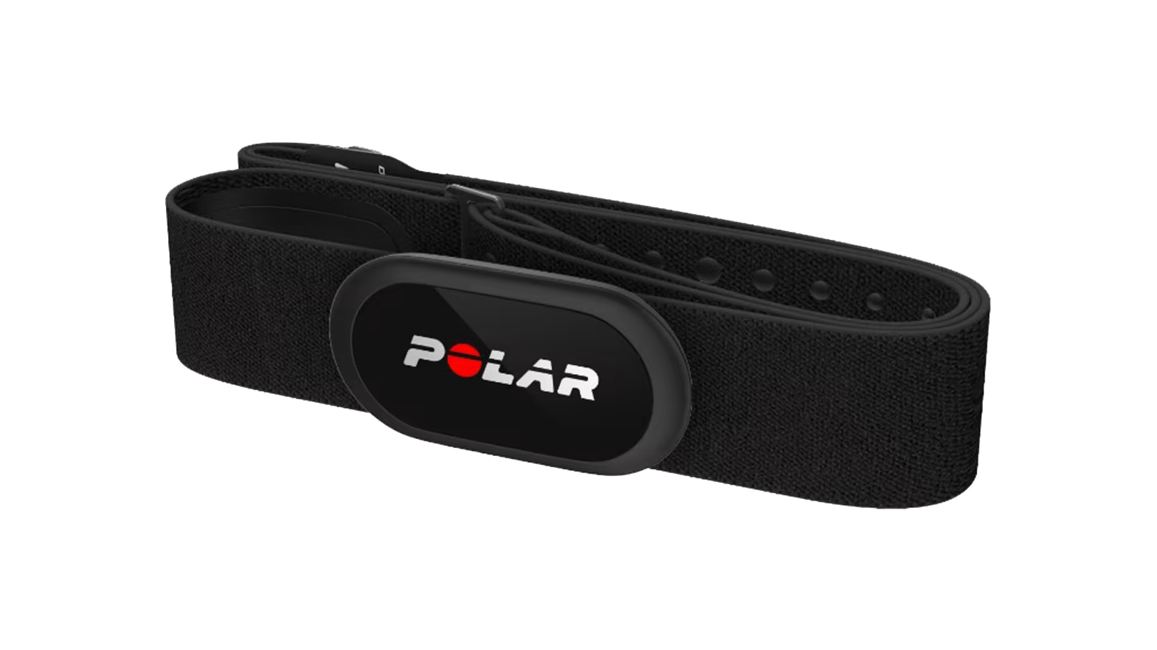
Our prior work* assessed reproducibility of stress detection models across multiple studies, testing models trained on one dataset against others using heart rate (with R-R interval) and EDA...
*Mishra, Varun, et al. "Evaluating the reproducibility of physiological stress detection models." Proceedings of the ACM on interactive, mobile, wearable and ubiquitous technologies 4.4 (2020): 1-29.

Slide 6

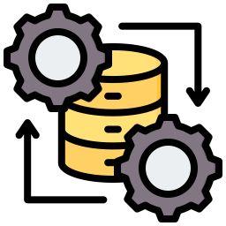


Development of Stress Prediction Tool for Evaluating Reproducibility
Data Collection from Stress and Non-Stress Periods
Physiological Signal Selection & Pre-processing
Machine Learning Models Training & Evaluation
Feature Extraction

Slide 7
Development of Stress Prediction Tool for Evaluating Reproducibility
Data Collection from Stress and Non-Stress Periods
Physiological Signal Selection & Pre-processing
Machine Learning Models Training & Evaluation
Feature Extraction

Slide 8

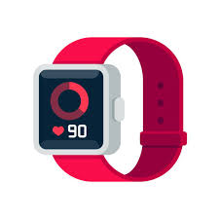
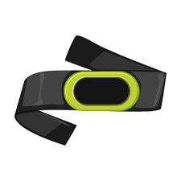
Development of Stress Prediction Tool for Evaluating Reproducibility
Data Derived from Four Independent Studies
Data collected from studies’ stress-inducing tasks: mental arithmetic, startle response, and cold pressor, with variations in task order, and context
Two Wearable Devices Used
Used Polar H7/H10 chest straps for heart rate monitoring, and Empatica E4 wristbands to collect EDA

Slide 9
Development of Stress Prediction Tool for Evaluating Reproducibility
Data Collection from Stress and Non-Stress Periods
Physiological Signal Selection & Pre-processing
Machine Learning Models Training & Evaluation
Feature Extraction

Slide 10
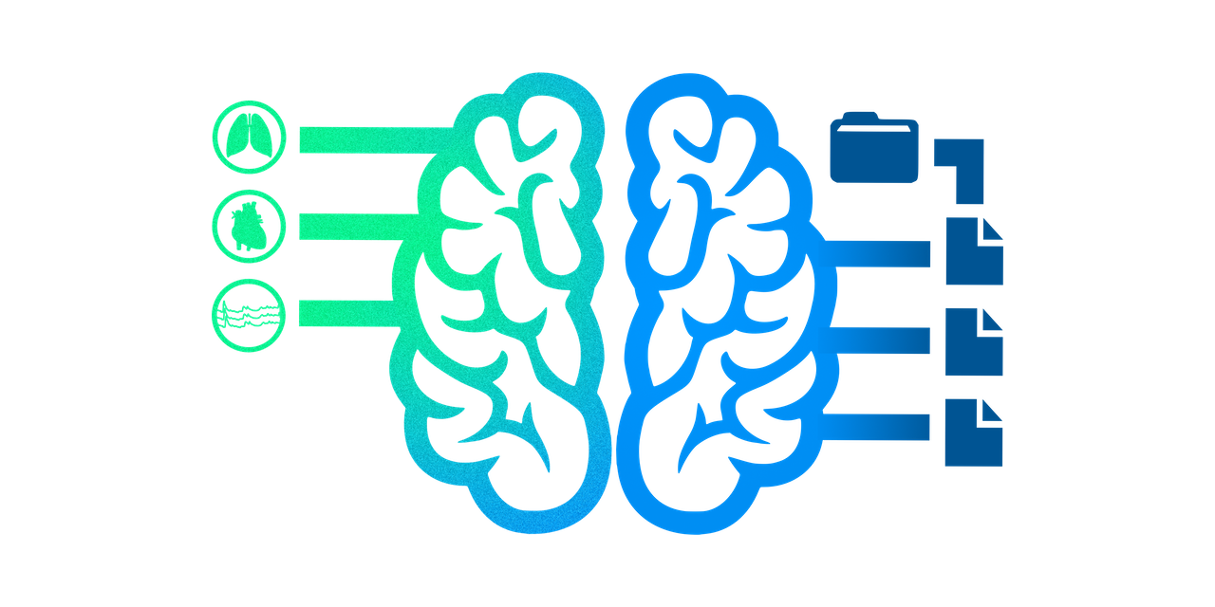
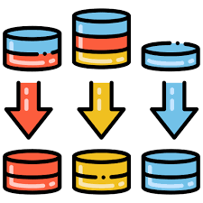
Development of Stress Prediction Tool for Evaluating Reproducibility
Selected Physiological Data
Selected HR, HRV, and EDA data, with preprocessing applied to standardize both; excluded HR values outside 30–220 bpm and EDA values below 0.01 µS or above 100 µS
Artifact Removal and Signal Normalization Technique
Removed HR and HRV outliers using a ±3×MAD threshold; smoothed EDA with a 5-second median filter; normalized HR and RR intervals with Z-score, and EDA with min-max normalization and decomposed EDA into tonic and phasic components

Slide 11
Development of Stress Prediction Tool for Evaluating Reproducibility
Data Collection from Stress and Non-Stress Periods
Physiological Signal Selection & Pre-processing
Machine Learning Models Training & Evaluation
Feature Extraction

Slide 12

Development of Stress Prediction Tool for Evaluating Reproducibility
Sliding Window Segmentation
Extracted physiological stress features using a 60-second sliding window with a 45-second overlap to capture short-term variations
Extracted Features
Calculated time-domain features: mean, standard deviation, skewness, and percentiles from HR and R-R intervals; and statistical features: peak count and AUC, from EDA

Slide 13
Development of Stress Prediction Tool for Evaluating Reproducibility
Data Collection from Stress and Non-Stress Periods
Physiological Signal Selection & Pre-processing
Machine Learning Models Training & Evaluation
Feature Extraction

Slide 14


Development of Stress Prediction Tool for Evaluating Reproducibility
Choice of ML Models
Applied SVM and RF models based on prior evidence of strong performance; SVM performed best with HR and R-R features, while RF excelled when EDA was included
Cross-Study Evaluation
Conducted LOSO cross-validation, SVM (RBF kernel, C=107, γ=0.001) and RF (100 trees) being trained on one dataset and tested on others without hyperparameter tuning

Slide 15
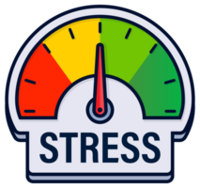

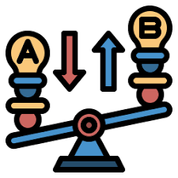

Extending Stress Detection Reproducibility with Multi-Device Testing
Conducting In-Lab Stress Induction
Testing & Evaluating Stress Detection ML Models
Comparative Analysis of Model Performance Across Devices
Finding Insight

Slide 16
Extending Stress Detection Reproducibility with Multi-Device Testing
Conducting In-Lab Stress Induction
Testing & Evaluating Stress Detection ML Models
Comparative Analysis of Model Performance Across Devices
Finding Insight

Slide 17
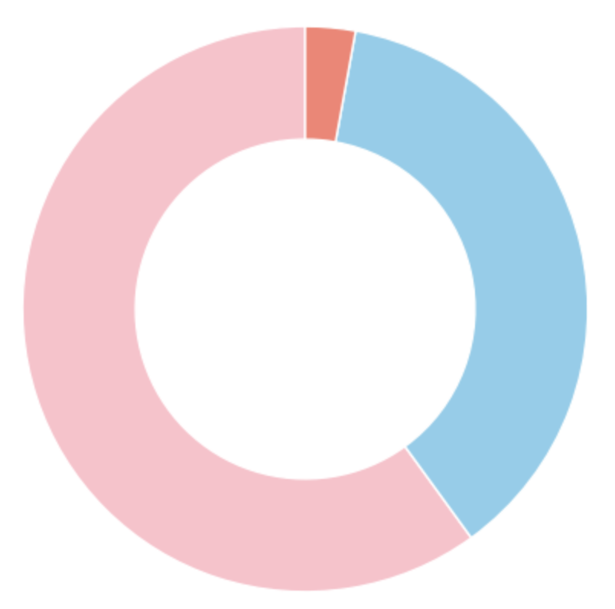
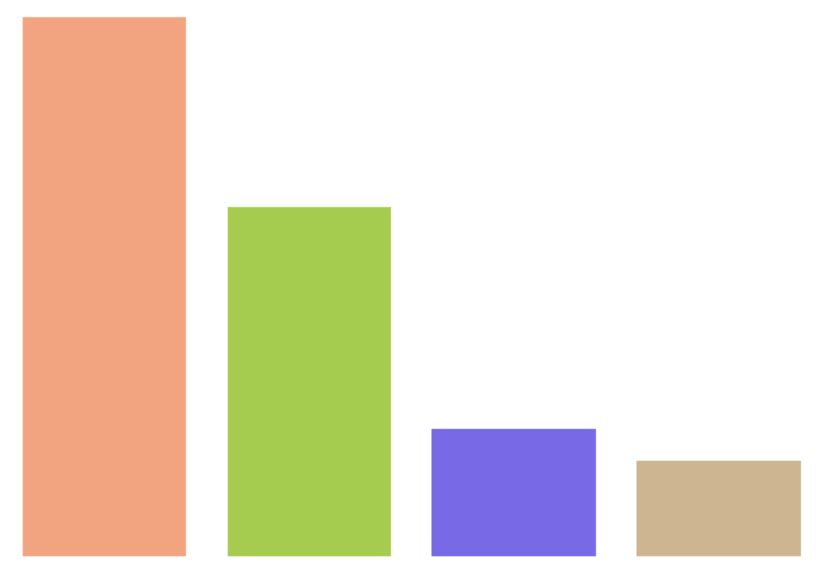
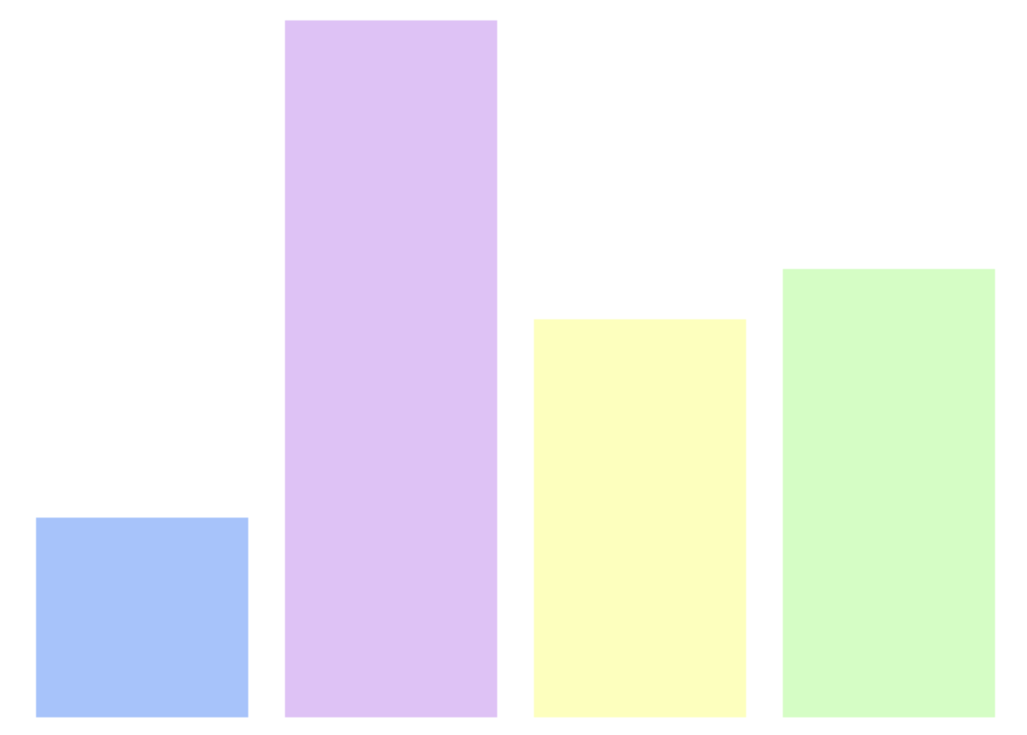
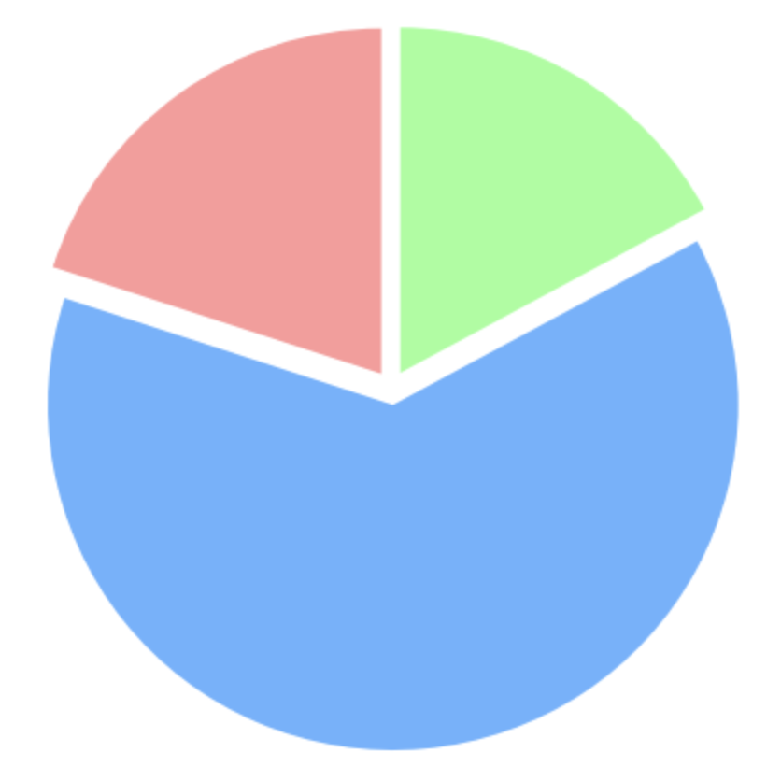
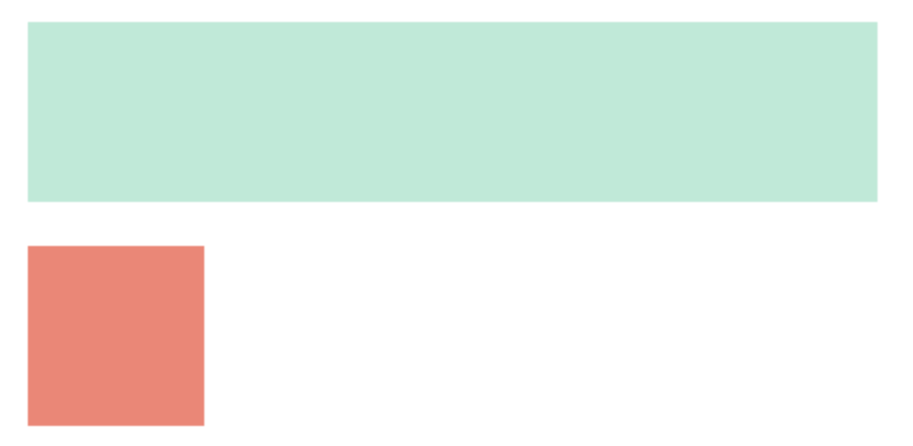
Socio Demographics of 35 Participants
Race
Gender
Non-binary: 1
17
11
Male: 13
Academic Year
4
3
14
White
Asian
Black
Other
Female: 21
Age
Ethnicity
9
8
Below 20: 7
Above 22: 6
Not Hispanic: 29
4
Hispanic: 6
Freshman
Sophomore
Junior
Senior
20 to 22: 22

Slide 18
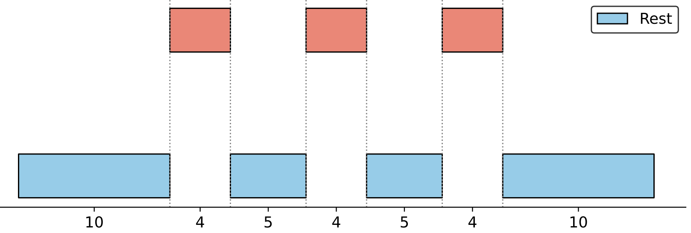
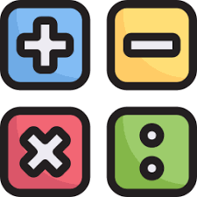
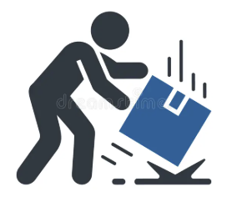
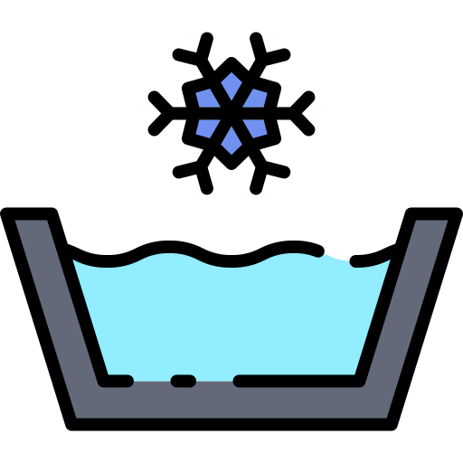
Lab Protocol Timeline
Mental Arithmetic
Startle Response
Cold Pressor
Rest
10 min
4 min
5 min
4 min
5 min
4 min
10 min

Slide 19
Extending Stress Detection Reproducibility with Multi-Device Testing
Conducting In-Lab Stress Induction
Testing & Evaluating Stress Detection ML Models
Comparative Analysis of Model Performance Across Devices
Finding Insight

Slide 20

Development of Stress Prediction Tool for Evaluating Reproducibility
Applying ML Models
Applied pre-trained reproducible model and trained-tested SVM & RF models with LOSO evaluation for Scenario 1: All stress tasks vs. rest and Scenario 2: Mental arithmetic vs. rest

Slide 21
Extending Stress Detection Reproducibility with Multi-Device Testing
Conducting In-Lab Stress Induction
Testing & Evaluating Stress Detection ML Models
Comparative Analysis of Model Performance Across Devices
Finding Insight

Slide 22
LOSO Cross-Validation
Training Data | Rest vs. All Stressors | Rest vs. Mental Arithmetic Stressor
Biopac MP160 | HRV: 0.776 [0.566-0.834] HRV+EDA: 0.984 [0.908 - 0.995] | HRV: 0.755 [0.50-0.918] HRV+EDA: 1.0 [0.941 - 1.0]
Polar H10 | HRV: 0.73 [0.62-0.84] | HRV: 0.954 [0.85-0.983]
Empatica E4 | HRV: 0.61 [0.51-0.77] HRV+EDA: 0.884 [0.698- 0.944] | HRV: 0.905 [0.848-0.974] HRV+EDA: 0.953 [0.606- 0.999]
Garmin Forerunner 55s | HRV: 0.73 [0.51-0.81] | HRV: 0.961 [0.899-0.998]
*Cells denote the median AUROC score across all students, along with the inter-quartile range

Slide 23
LOSO Cross-Validation
Training Data | Rest vs. All Stressors | Rest vs. Mental Arithmetic Stressor
Biopac MP160 | HRV: 0.776 [0.566-0.834] HRV+EDA: 0.984 [0.908 - 0.995] | HRV: 0.755 [0.50-0.918] HRV+EDA: 1.0 [0.941 - 1.0]
Polar H10 | HRV: 0.73 [0.62-0.84] | HRV: 0.954 [0.85-0.983]
Empatica E4 | HRV: 0.61 [0.51-0.77] HRV+EDA: 0.884 [0.698- 0.944] | HRV: 0.905 [0.848-0.974] HRV+EDA: 0.953 [0.606- 0.999]
Garmin Forerunner 55s | HRV: 0.73 [0.51-0.81] | HRV: 0.961 [0.899-0.998]

Slide 24
Pre-trained Mishra et al. Model Evaluation
Training Data | Rest vs. All Stressors | Rest vs. Mental Arithmetic Stressor
Biopac MP160 | HRV: 0.762 [0.523-0.867] HRV+EDA: 0.970 [0.926, 0.994] | HRV: 0.794 [0.314-0.926] HRV+EDA: 0.999 [0.929, 1.000]
Polar H10 | HRV: 0.729 [0.599-0.844] | HRV: 0.961 [0.858-0.998]
Empatica E4 | HRV: 0.548 [0.443-0.834] HRV+EDA: 0.736 [0.550, 0.865] | HRV: 0.913 [0.835-0.969] HRV+EDA: 0.723 [0.401, 0.964]
Garmin Forerunner 55s | HRV: 0.748 [0.509-0.842] | HRV: 0.968 [0.886-0.998]

Slide 25
Pre-trained Mishra et al. Model Evaluation
Training Data | Rest vs. All Stressors | Rest vs. Mental Arithmetic Stressor
Biopac MP160 | HRV: 0.762 [0.523-0.867] HRV+EDA: 0.970 [0.926, 0.994] | HRV: 0.794 [0.314-0.926] HRV+EDA: 0.999 [0.929, 1.000]
Polar H10 | HRV: 0.729 [0.599-0.844] | HRV: 0.961 [0.858-0.998]
Empatica E4 | HRV: 0.548 [0.443-0.834] HRV+EDA: 0.736 [0.550, 0.865] | HRV: 0.913 [0.835-0.969] HRV+EDA: 0.723 [0.401, 0.964]
Garmin Forerunner 55s | HRV: 0.748 [0.509-0.842] | HRV: 0.968 [0.886-0.998]

Slide 26
Extending Stress Detection Reproducibility with Multi-Device Testing
Conducting In-Lab Stress Induction
Testing & Evaluating Stress Detection ML Models
Comparative Analysis of Model Performance Across Devices
Finding Insight

Slide 27
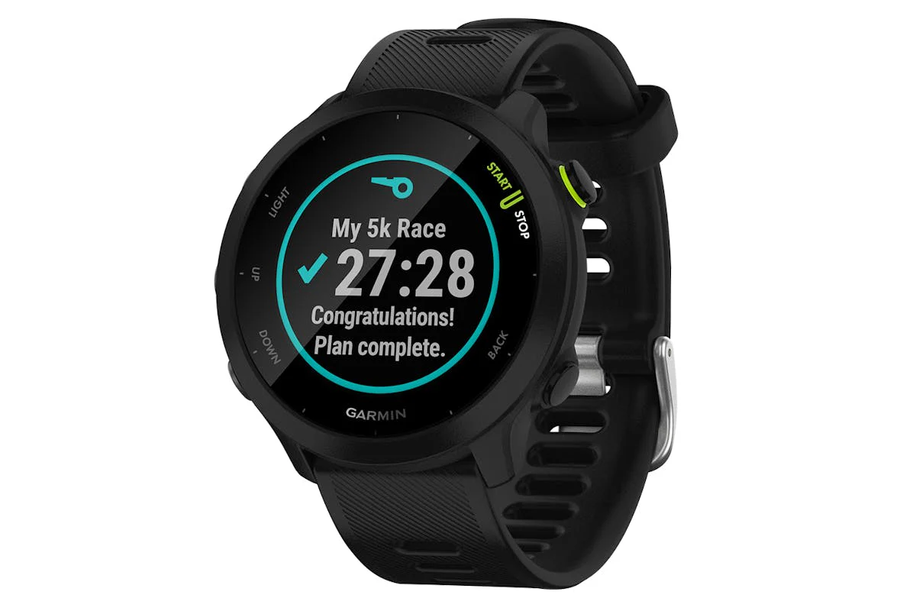
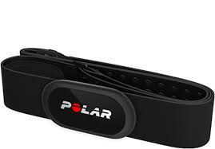
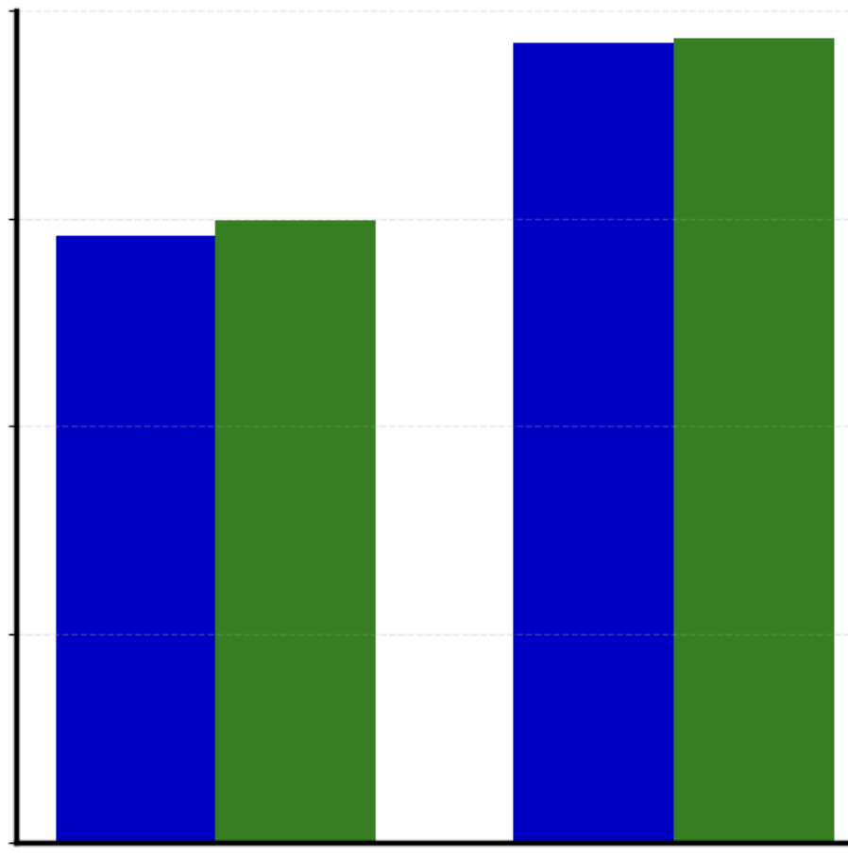
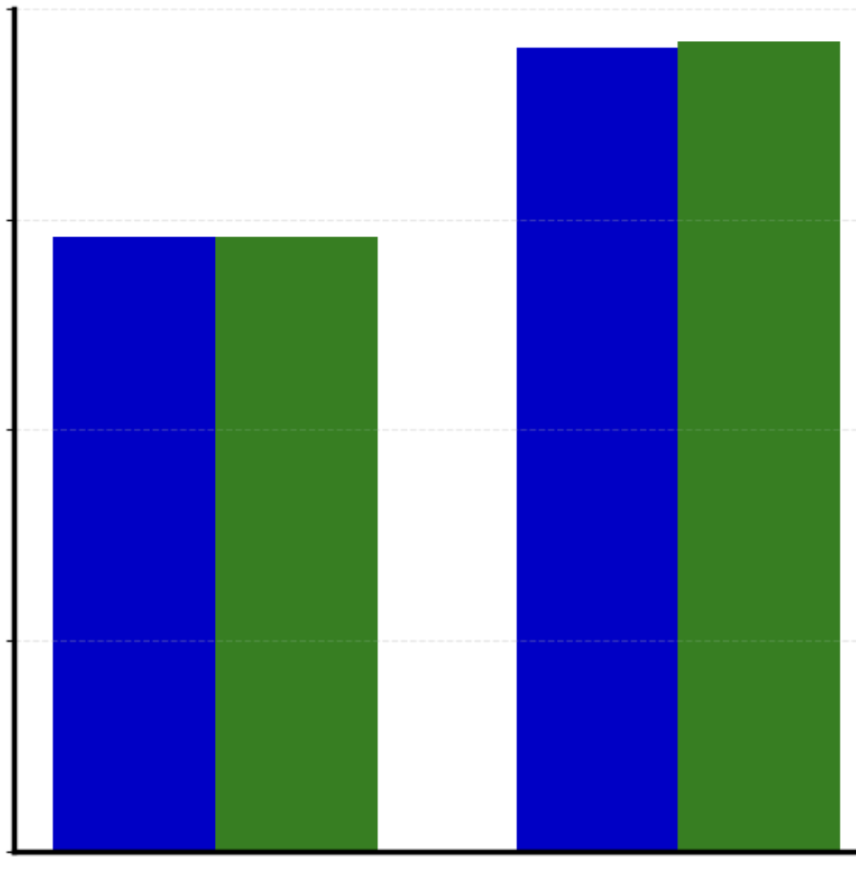
Comparative Performance Between
Garmin Forerunner 55s vs Polar H10
Pre-trained Mishra et al. Model Evaluation
LOSO Cross-Validation
1
1
.75
.75
.50
.50
.25
.25
0
0
Rest vs All Stressor
Rest vs Math
Stressor
Rest vs All Stressor
Rest vs Math
Stressor

Slide 28
Comparative Performance Between
Garmin Forerunner 55s vs Polar H10
Pre-trained Mishra et al. Model Evaluation
LOSO Cross-Validation
difference: +0.007
difference: +0.007
1
1
difference: 0.000
difference: +0.019
.75
.75
.50
.50
.25
.25
0
0
Rest vs All Stressor
Rest vs Math
Stressor
Rest vs All Stressor
Rest vs Math
Stressor

Slide 29
Garmin Forerunner 55s demonstrated strong potential for real-world stress monitoring, achieving the best mental arithmetic stress detection performance comparable to research-grade devices, Polar H10, and Empatica E4, with the added advantage of consumer friendly wearability for free-living contexts…

Slide 30
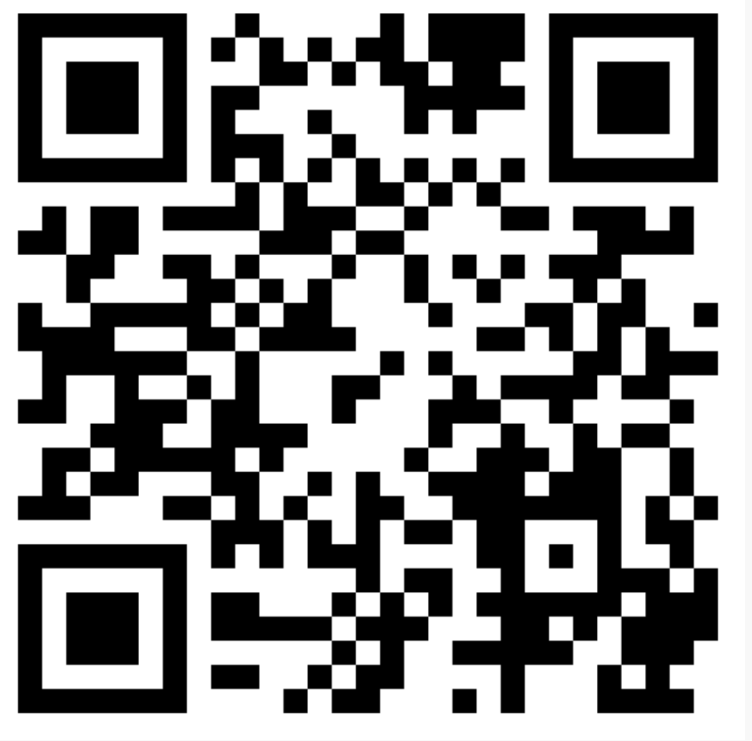
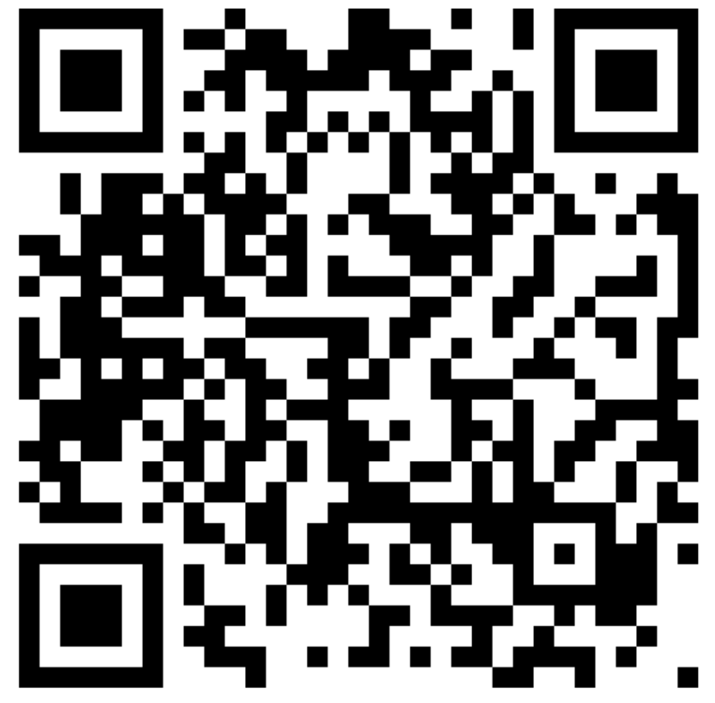
Please read our full paper:
Thank
You!
Please feel free to connect:
THE
Ohida Binte Amin
Email ID: amin.o@northeastern.edu
LAB

